Slide 1
“What is unique about intercultural Citizenship Education?” Alexandria, December 17, 2012

Slide 2
Introductory Assumptions
Identity
Personal / individual
Complex, flexible, multidimensional (different spheres of belonging)
Diversity
Fact that needs to be accepted, acknowledged, valued, promoted and managed (denial that generates)
Cultural diversity is as a source of exchange, innovation and creativity (UNESCO declaration, 2001, Art. 1)
Education as capacity building about diversity management on the citizenship level
Citizenship
Geographical area, Sociopolitical framework (City, Country, Region [Arab, Europe?]; Euromed)
Attitude, awareness, behavior (based on rights [civil, political, social]; freedoms; participation; values)
Intercultural citizenship education
Empowering and Stimulating people to contribbute to social cohesion and cultural enrichment with respect for diversity and on the basis of equality (Steven++).

Slide 3
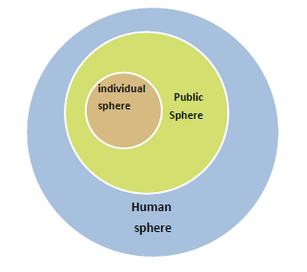
Ideological Monolithic citizenship
No place for diversity
ideology of a monolithic national identity and static public values
No intermediate level between citizen and state
Melting pot process

Slide 4
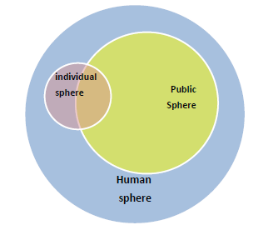
Humanistic Citizenship
Holistic understanding of Humanity
Respect for the individual uniqueness
No intermediate level between citizen and state
“Glocal” identification process

Slide 5
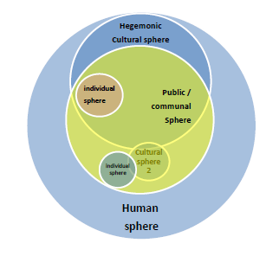
Communitarian Citizenship
Only one culture is recognized as reference for the public sphere
No chance for real intercultural relations and contribution to the public life
Citizenship and political participation are understood in a dualistic approach (with / against ; within / outside…)
Communitarianism process - discrimination

Slide 6
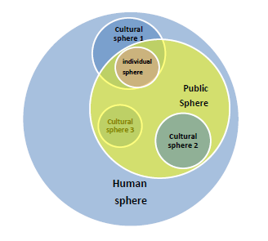
Multicultural Citizenship
Recognition of the cultural dimension of the citizen’s identity
Respect for the cultural diversity without chance for social contribution
toleration from the mainstream national community towards minorities
Risk of Ghettoisation and communitarian process and tyranny of minority on its followers

Slide 7
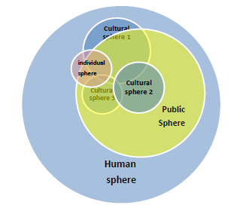
Intercultural Citizenship
Recognition of the cultural dimension of the citizen’s identity
Beyond tolerance, recognition of the contribution of each culture to the society
The citizenship culture built through an ongoing intercultural dialogue and identification of shared public values

Slide 8
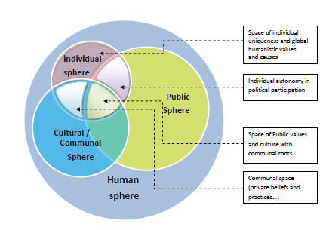
Intercultural Citizenship

